Slide 1
POTASSIUM NUTRITION
OF COTTON
Robert Mullen
Director of Agronomy

Slide 2
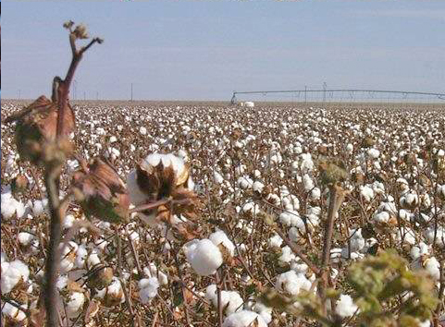
Potassium Nutrition of Cotton
Notes:
Potassium Nutrition of Cotton
Prepared by:
Dr. Cliff Snyder (csnyder@ipni.net)
Dr. Mike Stewart (mstewart@ipni.net)
International Plant Nutrition Institute (IPNI)
Norcross, Georgia U.S.A.
Updated January 2007

Slide 3
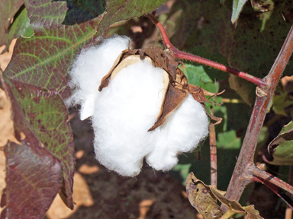
Outline – K Nutrition of Cotton
U.S. cotton yields since 1975
Growth and development of the cotton plant
Nutrient uptake
General K nutrition and response
K placement and timing considerations
Foliar application
Conclusions

Slide 4
U.S. Cotton Yield, 1975 to Present . . . An Increasing Trend
Lint, lb/A
Year
Source: USDA-NASS
Notes:
Cotton yields have trended upward in recent decades. Increased yields, especially with shorter-season cotton varieties, will require optimum fertility management to meet nutrient uptake demands and to replace harvested nutrients.
Source: USDA/NASS
http://www.nass.usda.gov:81/ipedb/

Slide 5
A Production Timeline for Irrigated Cotton in the Texas High Plains
May
June
July
August
September
October
Nov
Emergence
Squaring
1st bloom
Peak bloom
1st open boll
95% mature
Harvest
0
10
20
30
40
50
60
70
80
90
100
110
120
130
140
150
160
0
80
525
1060
1470
1640
2280
Approximate days
after planting
Approximate heat
units after planting
Source: R. Boman
Notes:
In relation to production and management, the cotton plant has five main growth stages: 1) germination and emergence, 2) seedling establishment, 3) leaf area and canopy development, 4) flowering and boll development, and 5) maturation. An effective way of assessing the development, or progression of physiological events, of a cotton plant is with heat units or growing degree days. A heat unit is expressed in degrees Fahrenheit and is defined by the following equation:
Heat Unit = [(daily maximum temperature + daily minimum
temperature) ÷ 2] – 60.
This slide shows a timeline that generally describes the relationships among time, heat unit accumulation, and cotton development on the Texas High Plains.
Source: Dr. Randy Boman, Extension Agronomist-Cotton, Texas Cooperative Extension, Lubbock, TX.

Slide 6
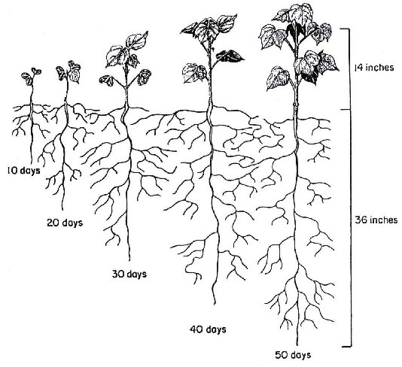
Early Season Root Development of the Cotton Plant
Source: Oosterhuis, 1990
Notes:
Early-season root growth helps ensure that plants access moisture and nutrients efficiently. Any restriction in early root development may prevent rapid root and shoot expansion during peak growth periods, from squaring through peak bloom: about 60 to 100 days after planting.
Source: Oosterhuis, D.M. 1990. Growth and development of a cotton plant. p. 1-24. In W.N. Miley and D.M. Oosterhuis (eds.), Nitrogen Nutrition of Cotton: Practical Issues. Proceedings of First Annual Workshop for Practicing Agronomists. American Society of Agronomy. Madison, WI.

Slide 7
Cotton Root Length as Affected by Days After Planting (Field Study)
Roots, ft/plant
Based on 36,000 plants/A, there were 9,545 miles of roots /A
First bloom
4 true leaves
Late bloom/early boll filling
Days after planting
Source: Schwab, Mullins & Burmester, 2000
Notes:
Healthy root growth promotes healthy shoot growth and top yields. Data in this slide are for a single growing season on a fertile Dewey silt loam soil in North Alabama. Cotton (Deltapine 51) lint yields were considered excellent for this soil, location, and year: 1,513 lb/A.
Maximum root length occurred at about 117 days after planting, or several weeks into boll filling.
Maximum root length occurred approximately 11 days before dry matter production peaked (128 days after planting).
After first bloom, about 70% of the cotton root system was located in the 0 to 6 and 6 to 12-in. soil layers.
Source: Schwab, G.J., G.L. Mullins, and C.H. Burmester. 2000. Growth and nutrient uptake by cotton roots under field conditions. Comm. Soil Sci. Plant Anal. 31(1 &2):149-1.

Slide 8
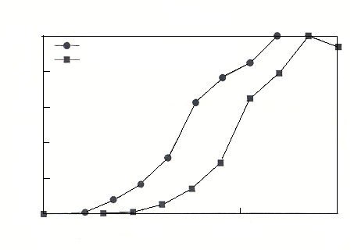
Older K Uptake Pattern vs. Newer Uptake Pattern
A comparison of the percentages of maximum K and dry matter accumulated during the growing season by cotton grown in 1940 versus the mid-1980s
100
Mullins and Burmester (1990)
80
Olson and Bledsoe (1942)
60
% of total
40
Newer varieties accumulate K faster than older varieties
20
0
0
50
100
150
Notes:
Source: Mullins, G.L. and C.H. Burmester. 1997. Potassium uptake by crops during the season. Ch. 15. pp. 123-132. In D.M. Oosterhuis and G. A. Berkowitz (eds.). Frontiers in Potassium Nutrition: New perspectives on the effects of potassium on physiology of plants. Proc. of a symposium sponsored by PPI and the Crop Science Society of America. November 1996. PPI. Norcross, GA.

Slide 9
Cotton Nutrient Uptake Compared to Yield
Where – Who | Year | Cotton Type | Lint Yield (lb/A) | N | P₂O₅ | K₂O
 |  |  |  | - - lb per 100 lb of lint - -
GA-Olson | 1942 | Upland | 760 | 18 | 8 | 18
CA - Bassett* | 1970 | Acala | 1,450 | 10 | 3 | 11
Israel - Halevy* | 1976 | Acala | 1,580 | 14 | 6 | 12
AL - Mullins | 1990 | Upland | 880 | 20 | 6 | 18
LA - Breitenbeck | 1993 | Upland | 1,230 | 14 | 6 | 13
AZ – Unruh* | 1996 | Upland | 1,186 | 15 | 5 | 23
 | 1996 | Pima | 965 | 21 | 7 | 25
Removal in harvested crop
IPNI |  |  |  | 6.7 | 2.9 | 4.0
* Irrigated tests
Notes:
The amount of K₂O required for each pound of lint produced is about equal to the amount of N needed. The amount of K₂O required varies with the cotton type (Upland, Acala, Pima) as well as the irrigation regime. Work by Mullins and Burmester (1990) reported no significant differences in nutrient uptake requirement among four cotton cultivars, at similar yield levels.
Cotton K requirement per 100 lb of lint is as great today as it was six decades ago. With increased conservation tillage technologies, much of the cotton acreage is being planted using stale seedbeds, strip tillage and no-tillage. Soil temperatures in these production systems are often cooler at planting time, which increases the need for optimum soil test P and K levels and fertilization practices.
National average yields have increased from about 450 lb/A in 1975 to over 700 lb/A currently. Higher yields, and the development of faster fruiting varieties have influenced optimal K fertilization practices.
Sources: Georgia: Olson, L.C. and R.P. Bledsoe. 1942. The chemical composition of the cotton plant and the uptake of nutrients at different stages of growth. Bull. 222. Georgia Agric. Exp. Stn.
California: Bassett, D.M., W.D. Anderson, and C.H.E. Werkoven. 1970. Dry matter production and nutrient uptake in irrigated cotton (Gossypium hirsutum). Agron. J. 62:299-303.
Israel: Halevy, J. 1976. Growth rate and nutrient uptake of two cotton cultivars under irrigation. Agron. J. 68:701-705.
Alabama: Mullins, G.L. and C.H. Burmester. 1990. Dry matter , nitrogen, phosphorus, and potassium accumulation by four cotton varieties. Agron. J. 82:729-736.
Louisiana: Breitenbeck, G.A. and D.J. Boquet. 1993. Effects of nitrogen fertilization on nutrient uptake by cotton. p. 1298-1300. Proc. of the 1993 Beltwide Cotton Conferences.
Arizona: Unruh, B.L. and J.C. Silvertooth. 1996. Comparisons between an Upland and Pima cotton cultivar: II. Nutrient uptake and partitioning. Agron. J. 88:589-595.
IPNI: International Plant Nutrition Institute website >http://www.ipni.net<

Slide 10
Cotton Peak Nutrient Uptake Rate 60 to 100 Days After Planting
Source: Mullins and Burmester, 1990; Schwab et al., 2000
Notes:
Peak daily uptake of K can exceed 3 lb K/A (3.3 lb K₂O/A). Failure to maintain the uptake demand during peak periods will result in plant stress, yield loss, and a decline in lint quality.
Note: Nutrient uptake rates in newer cotton varieties may peak sooner and occur over a shorter time interval, compared to older varieties.
Sources:
Georgia: Olson, L.C. and R.P. Bledsoe. 1942. The chemical composition of the cotton plant and the uptake of nutrients at different stages of growth. Bull. 222. Georgia Agric. Exp. Stn.
California: Bassett, D.M., W.D. Anderson, and C.H.E. Werkoven. 1970. Dry matter production and nutrient uptake in irrigated cotton (Gossypium hirsutum). Agron. J. 62:299-303.
Israel: Halevy, J. 1976. Growth rate and nutrient uptake of two cotton cultivars under irrigation. Agron. J. 68:701-705.
Alabama: Mullins, G.L. and C.H. Burmester. 1990. Dry matter, nitrogen, phosphorus, and potassium accumulation by four cotton varieties. Agron. J. 82:729-736.
Schwab, G.J., G.L. Mullins, and C.H. Burmester. 2000. Growth and nutrient uptake by cotton roots under field conditions. Comm. Soil Sci. Pl. Anal. 31(1 &2):149-164

Slide 11
Maximum Daily Uptake of K, N, and P Occurs Near Peak Blooming
Lint yield 1,513 lb/A
Source: Schwab et al., 2000
Notes:
Cotton lint yields in this non-irrigated research conducted in 1994 on a Dewey silt loam (Typic Paleudult) averaged 1,513 lb of lint/A. Interestingly, P and K uptake peaked before N uptake peaked. The peak uptake occurred near the peak blooming period. Fluctuations in uptake rates of each major nutrient as the season progressed may indicate that plants experienced stress as they matured.
Source:
Alabama
Schwab, G.J., G.L. Mullins, and C.H. Burmester. 2000. Growth and nutrient uptake by cotton roots under field conditions. Comm. Soil Sci. Pl. Anal. 31(1 &2):149-164.

Slide 12
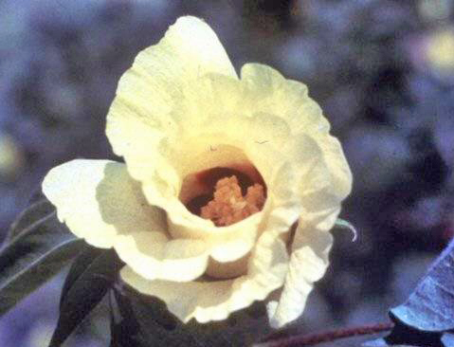
Facts about K in Cotton Production
Affects quality (micronaire, length, and strength)
Reduces the incidence and severity of wilt diseases
Increases water use efficiency
Functions in enzyme systems
Bolls are major sinks for K, uptake may reach 3 lb/A/day during boll development
About 70% of total uptake occurs after first bloom

Slide 13
K Uptake by Modern Cotton Varieties, Lint Yield 880 lb/A
Averaged across four varieties
Deltapine 90, Stoneville 825, Coker 315, Paymaster 145
K, lb/A
Source: Mullins & Burmester, 1990
Notes:
K uptake increases rapidly once cotton begins squaring and flowering. Potassium uptake continues to plant maturity, with more being allocated to burs and seed at the expense of leaves. Potassium levels should be high enough and plants should be vigorous enough to support K uptake and translocation from vegetative organs to fruiting structures as cotton bolls mature.
Source: Mullins, G.L. and C.H. Burmester. 1990. Dry matter, nitrogen, phosphorus, and potassium accumulation by four cotton varieties. Agron. J. 82:729-736.

Slide 14
K Compartmentation by Developing Cotton Bolls
N-P-K compartmentation is 140-32-122 mg/boll 4.7 - 1 - 4 ratio
Mature boll oven-dry weight ~ 6.5 grams
Bur
K, mg
Fiber
Seed
Days After Pollination
Source: Leffler. 1986. Cotton Physiology
Notes:
This slide illustrates the importance of optimum K nutrition in seed development and the increase in seed K concentration with boll maturity. Lint formation and development depends on adequate and sustained K nutrition throughout the plant’s life cycle.
Note that concentration of K in the seed is much higher than in the cotton fiber, and that the bur has the highest concentration. The K content of the bur and seed increases as the cotton matures, while the fiber K content declines Based on the data in this graph, the seed K concentration would be about 1.28 %.
Bassett and others (1970) reported that the whole cotton seed had a concentration of 0.9 to 1.3% K. The National Cotton Seed Products Association (NCSPA) lists the whole cottonseed (not delinted) K concentration as 1.14%. The NCSPA website is http://www.cottonseed.com/publications/feedproductsguide.asp
Sources:
Leffler, H.R. 1986. Mineral compartmentation within the boll. Chapter 21, p. 301-309. In J.R. Mauney and J.McD. Stewart (eds.), Cotton Physiology. The Cotton Foundation. Memphis, TN.
Bassett, D.M., W.D. Anderson, and C.H.E. Werkoven. 1970. Dry matter production and nutrient uptake in irrigated cotton (Gossypium hirsutum). Agron. J. 62:299-303.

Slide 15
Reasons to Build Soil Test K
Stimulate photosynthetic efficiency
Enhance efficient use of soil moisture
Increase root growth for efficient uptake of other nutrients
Capitalize on “good weather” years
Minimize risk associated with “bad weather” years
Raise soil productivity
Increase yield potential of all crops in the rotation
Improve grower profit potential
Rules of thumb for raising soil test K
8 to 16 lb K₂O needed above crop removal to build soil test K by 1 ppm on sandy loam to silt loam soils
Notes:
To ensure proper seed and lint development, adequate soil K levels must be built and maintained. There are other important reasons to build soil test K levels into the high or medium to high range, as noted in this slide.
The amount of K required to raise soil test K levels depends on the soil texture (clay content), type of clay minerals, soil organic matter content, crop yields, and harvest removal of K, as well as tillage system.
The best way to determine the amount of K required for a specific soil and management program is to soil test. Soil testing on a relatively frequent basis (at least every 3 years, and preferably every other year), will enable the farmer or crop adviser to establish a soil test response curve that is specific to that farming situation.

Slide 16
Probability of a K Response
Category definitions vary among laboratories
Notes:
This table illustrates the general probability of response to K fertilizer under different soil K fertility levels. Note that neither the amount of yield increase with K addition, nor the amount of K fertilizer required, are identified with this general table. Only field research can identify the amount of fertilizer K required and the potential yield increase at a given soil test K level.

Slide 17
Annual K Fertilization Has Advantages Over Residual K Fertility
Notes:
This study in Alabama was conducted on a Dewey silt loam with an initial low soil test K rating. Annual K fertilizer application resulted in consistently higher cotton lint yields each year of the study. The differences were statistically significant in those years when a response to K fertilization rate was observed. Somewhat surprisingly, there was no interaction between K fertilization rate and residual vs. annual fertilization.
Annual K fertilization on sandy soils is necessary, but these data indicate there are advantages to annual fertilization on some silt loam soils also.
Source: Mullins, G.L., G.J. Schwab, and C.H. Burmester. 1999. Cotton response to surface applications of potassium fertilizer: a 10-year summary. J. Produc. Agric. 12:434-440.

Slide 18
Cotton Response to Time and Rate of K Application in Alabama
Cotton Lint Yield, lb/A
0-0
0-60
0-120
120-0
60-60
90-90
0-180
Source: Mullins et al. 1999
Notes:
On this silt loam soil in the Limestone valley area in north Alabama, fall vs. spring timing of K application did not matter. The authors of the paper concluded that the rate of K was more important than the timing of application.
Source: Mullins, G.L., G.J. Schwab, and C.H. Burmester. 1999. Cotton response to surface applications of potassium fertilizer: a 10-year summary. J. Produc. Agric. 12:434-440.

Slide 19
Auburn University Research
On low K soils, if a producer applies 90 lb K₂O/A/year for 10 years, one might expect an average increase of 2.7 lb lint/lb K₂O applied
On medium K soils, if a producer applies 60 lb K₂O for 6 years, one could expect 2.0 lb lint/lb K₂O applied
Lint yield peaked at a soil test of about 250 lb/A Mehlich 1 extractable K on a silt loam soil
In some years, K fertilization increased lint yields by more than 450 lb/A
Notes:
Source: Mullins, Schwab, and Burmester at Auburn University (1999. J. Prod. Agric.12:434-440).

Slide 20
Relative Cotton Yield on Two Silt Loam Soils as Affected by Soil Test K
Relative Yield, %
In-row soil test K for 95% of maximum yield was about 350 lb/A
In-Row Mehlich 1 Soil Test K, lb/A
Source: D. Howard. 1997 soil test and 1998 yield in TN
Notes:
The critical soil test level for 95% of maximum cotton yield varies with soil texture, soil mineralogy, cropping system, and also the soil extractant used. The sampling position (within rows, between rows, or random) can also have a profound affect on soil test K interpretation and fertilizer K recommendations.
For many soils, where soil samples are collected randomly within and between cotton rows, having extractable soil test K levels above 240 to 250 lb/A (Mehlich 1), above 300 to 350 lb/A (Mehlich 3), and above 320 lb/A (Lancaster) will help to reduce the potential for K deficiency and reduced yields.
Sources:
Howard, D.D., M. Essington, R.M. Hayes, and W. Percell. 2001. Potassium fertilization of conventional and no-till cotton. J. Cotton Sci. 5:197-205.
Mullins, G.L., G.J. Schwab, and C.H. Burmester. 1999. Cotton response to surface applications of potassium fertilizer: a 10-year summary. J. Produc. Agric. 12:434-440.
Adeli, A. and J.J. Varco. 2002. Potassium management effects on cotton yield, nutrition, and soil potassium level. J. Plant Nutrition 25:.2229-2242.
Crozier, C.R., B. Walls, D.H. Hardy, and J. S. Barnes. 2004. Response of Cotton to P and K Soil Fertility Gradients in North Carolina. J. Cotton Sci. 8:130-141.

Slide 21
Cotton Response to K₂O in Mississippi
0 to 6-in. soil K=211 lb/A, (medium level, by Lancaster extraction) 6 to 12-in. soil K=120 lb/A
Notes:
Adequate K raises lint yield, individual boll weight, and lint recovery from seedcotton (turnout), and it increases seed weight.
In addition to the above benefits, adequate K results in a higher leaf area index (more leaves to capture sunlight), increases the number of main stem nodes, and tends to increase plant height. Although N uptake efficiency may not be affected by K fertility, plants that receive K fertilization may have increased efficiency of fertilizer N use and N utilization within the plant.
Sources:
Pettigrew, W.T., J.J. Heitholt, and W.R. Meredith, Jr. 1996. Genotypic interactions with potassium and nitrogen in cotton of varied maturity. Agron. J. 88:89-93.
Pettigrew, W.T. and W.R. Meredith, Jr. 1997. Dry matter production, nutrient uptake, and growth of cotton as affected by potassium fertilization. J. Plant Nutrition 20(4 & 5):531-548.

Slide 22
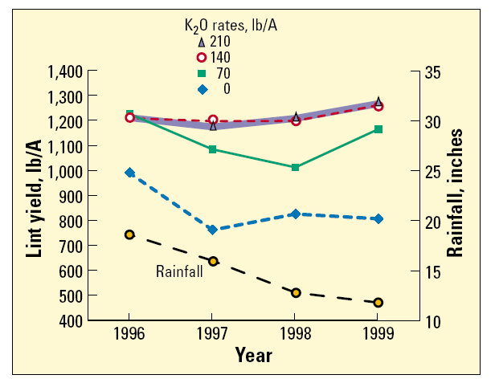
Adequate K Helps Sustain Yields in Seasons with Lower Rainfall
Source: Varco. 2000. Mississippi
Notes:
Source: Varco, J.J. 2000. No-tillage cotton responds to potassium on high CEC soils. Better Crops. Vol. 84(4):21-23.

Slide 23
Cotton K Response May Be Greater with No-Till Compared to Disced or Plowed Systems
Leeper silty clay loam - Mississippi
Lint yield, lb/A
Initial Lancaster soil test K =157 ppm
(Lancaster extracts 15 to 20% more K than Mehlich 3)
(72) (144) (216)
K₂O rate, lb/A
Source: Varco. 2000. Mississippi
Notes:
Source: Varco, J.J. 2000. No-tillage cotton responds to potassium on high CEC soils. Better Crops. Vol. 84(4):21-23.

Slide 24
Soil K Stratification in No-Till Cotton
Test conducted from 1991 through 1996 on a Memphis silt loam soil in west Tennessee. Soil samples were collected after crop harvest in the fall of 1996. Cotton was planted within a few inches of the original rows each year.
Sample depth & position:
IR-in-row
BR=between-rows
Initial K @ 0 to 6 in. = 40 ppm
Mehlich 1K, ppm
Annual K Rate, lb K₂O/A
Source: Howard et al. 1999
Notes:
Mehlich 1 extractable soil K was significantly affected by K fertilization rate, soil depth, and sampling position. Mehlich 1 soil K was greater for the in-row sampling position of the 0- to 8-cm (0-3 in.) sampling depth (for three silt loam soils studied). Soil sampling only between the planted rows may result in a lower soil test value, and cause higher fertilizer K recommendations. Differences in stratification (in-row or between rows) varied with soil-applied K rates and may increase with additional time in no-till cotton.
Source: Howard, D.D., M.E. Essington, and D.D. Tyler. 1999. Vertical phosphorus and potassium stratification in no-till cotton soils. Agron. J. 91:266-269.

Slide 25
Soil K Stratification in No-Till Cotton
Test conducted from 1991 through 1996 on a Memphis silt loam soil in west Tennessee. Soil samples were collected after crop harvest in the fall of 1996. Cotton was planted within a few inches of the original rows each year.
Sample depth & position:
IR-in-row
BR=between-rows
Initial K @ 0 to 6 in. = 40 ppm
Mehlich 1K, ppm
Annual K Rate, lb K₂O/A
Source: Howard et al. 1999
Notes:
Mehlich 1 extractable soil K was significantly affected by K fertilization rate, soil depth, and sampling position. Mehlich 1 soil K was greater for the in-row sampling position of the 0- to 8-cm (0-3 in.) sampling depth (for three silt loam soils studied). Soil sampling only between the planted rows may result in a lower soil test value, and cause higher fertilizer K recommendations. Differences in stratification (in-row or between rows) varied with soil-applied K rates and may increase with additional time in no-till cotton.
Source: Howard, D.D., M.E. Essington, and D.D. Tyler. 1999. Vertical phosphorus and potassium stratification in no-till cotton soils. Agron. J. 91:266-269.

Slide 26
Surface K Placement is Equal to or Superior to Subsurface Banding
Surface applied K was incorporated by discing 4 in. deep
Seedcotton yield, lb/A
Notes:
Many soils supporting cotton production in the Southeast U.S. have subsoil K levels rated as medium to low. These same soils frequently have hardpans that must be disrupted for optimum root growth, efficient moisture use, and nutrient acquisition.
Research by scientists with USDA-ARS and Auburn University showed:
stomatal conductance (opening of stomates or leaf pores) was not well related to the appearance of late-season leaf K-deficiency symptoms. There was trend for lower stomatal conductance with surface applied K, and subsoiling tended to reduce stomatal conductance.
subsoiling is necessary for maximum cotton yields on Coastal Plain soils with root-restricting hardpans.
based on seedcotton yield and leaf K concentrations, deep placement of K fertilizer proved no better than surface application.
Source: Reeves, D.W. and G.L. Mullins. 1995. Subsoiling and potassium placement effects on water relations and yield of cotton. Agron. J. 87:847-852.

Slide 27
Foliar K on Cotton
Under some conditions mid to late season foliar application of K on cotton can increase yield
Foliar K response increased where
soil K is low (low soil test level or fixation)
root uptake is compromised
petiole analysis indicates a pending shortage
Foliar K begins to enter plant within 6 hours
Maximum uptake occurs between 24 and 48 hours after application (60 to 65% of K)
K is translocated to bolls with little delay once absorbed
Notes:
Sources:
Kafkafi, U. 1992. Foliar feeding of potassium nitrate in cotton. Better Crops. Vol. 76(2):16-17.
Chang, M.A. and D.M. Oosterhuis. 1995. Cotton response to foliar applications of potassium compounds at different pH levels. Better Crops Vol. 79(2):20-22.
Howard, D.D., C.O. Gwathmey, and C.E. Sams. 1998. Foliar feeding of cotton: evaluating potassium sources, potassium solution buffering, and boron. Agron. J. 90:740-746
Roberts, R.K., D.C. Gerloff, and D.D. Howard. 1997 Foliar potassium on cotton – a profitable supplement to broadcast potassium on low testing soils. Better Crops Vol. 81(1):20-23
Oosterhuis, D.M. Foliar potassium fertilization of cotton. Pp. 87-99. In D.M. Oosterhuis and G.A. Berkowitz (eds.). Frontiers in Potassium Nutrition: New Perspectives on the effects of Potassium Nutrition on Physiology of Plants. 1997. Potash & Phosphate Institute.

Slide 28
Foliar K Research
3-year Beltwide test (Oosterhuis et al.,1994) showed variable response, with yield differences about 40% of the time
California studies from 1992-1999 showed an average of about 100 lb lint/A response to foliar K on soils with high K fixation (vermiculite mineralogy) and high yield potential
Notes:
Sources:
D.M. Oosterhuis, O. Abaye, D.W. Albers, W.H. Baker, C.H. Burmester, J.T. Cothren, M.W. Ebelhar, D.S. Guthrie, M.G. Hickey, S.C. Hodges, D.D. Howard, R.L. Hutchinson, L.D. Janes, G.L. Mullins, B.A. Roberts, J.C. Silvertooth, P.W. Tracy, and B.L. Weir. 1994. A summary of a 3-year beltwide study of soil and foliar fertilization with potassium nitrate in cotton. Proc. of the Beltwide Cotton Production Conferences. p. 1532-1533.
Weir, B.L. 1999. Effect of foliar-applied potassium on cotton in the San Joaquin Valley of California. Proc. of the Beltwide Cotton Production Conferences. Volume 21:1307-1310.

Slide 29
Typical Cotton Response to Foliar K Fertilization in California
Lint yield increase (lb/A)
Application, weeks after first flower
Notes:
Source:
Weir, B.L. 1999. Effect of foliar applied potassium on cotton in the San Joaquin Valley of California. Proc. of the Beltwide Cotton Production Conferences. Volume 21:1307-1310.

Slide 30
Cotton Response to Soil and Foliar K Fertilization in No-till and Disk-Till Systems (Tennessee)
Check
Fol. CaNO₃
Fol. KNO₃
No-Till System
Check
Fol. CaNO₃
Fol. KNO₃
Disk-Tilled System
Notes:
Cotton yield response to foliar K may differ among tillage systems. The probability of a profitable response to foliar K fertilization decreases with increasing soil K fertility, or increasing soil applied K rates.
Source:
Roberts, R.K., D.C. Gerloff, and D.D. Howard. 1997. Foliar potassium on cotton – a profitable supplement to broadcast potassium on low testing soils. Better Crops Vol. 81(1):20-23.

Slide 31
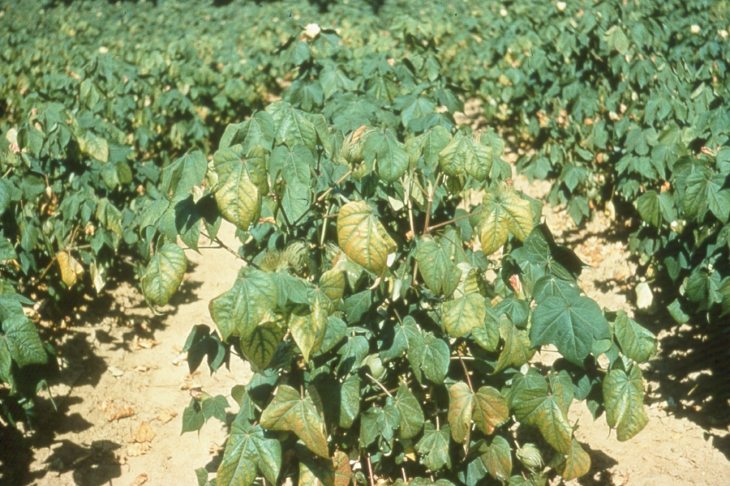
Prevent Cotton K Deficiency
Full-season K Deficiency
Notes:
Full-season K deficiency is likely to occur when both topsoil and subsoil K levels are low. Note that lower leaves tend to show deficiency symptoms first, but that symptoms can occur throughout the canopy as deficiency persists.

Slide 32
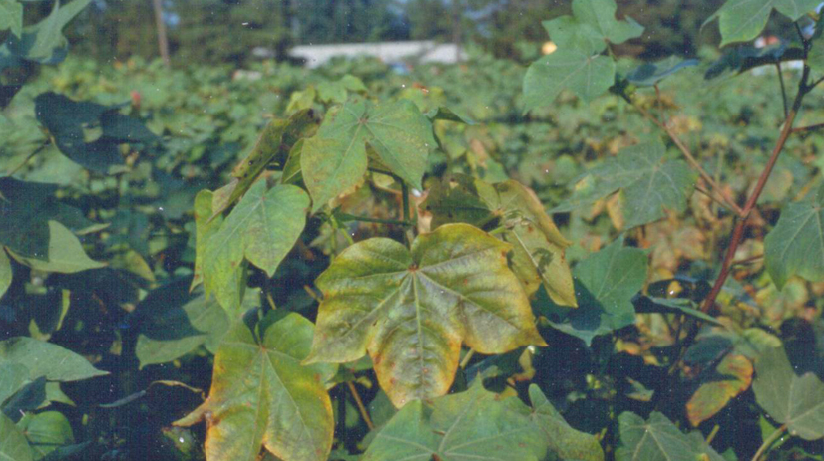
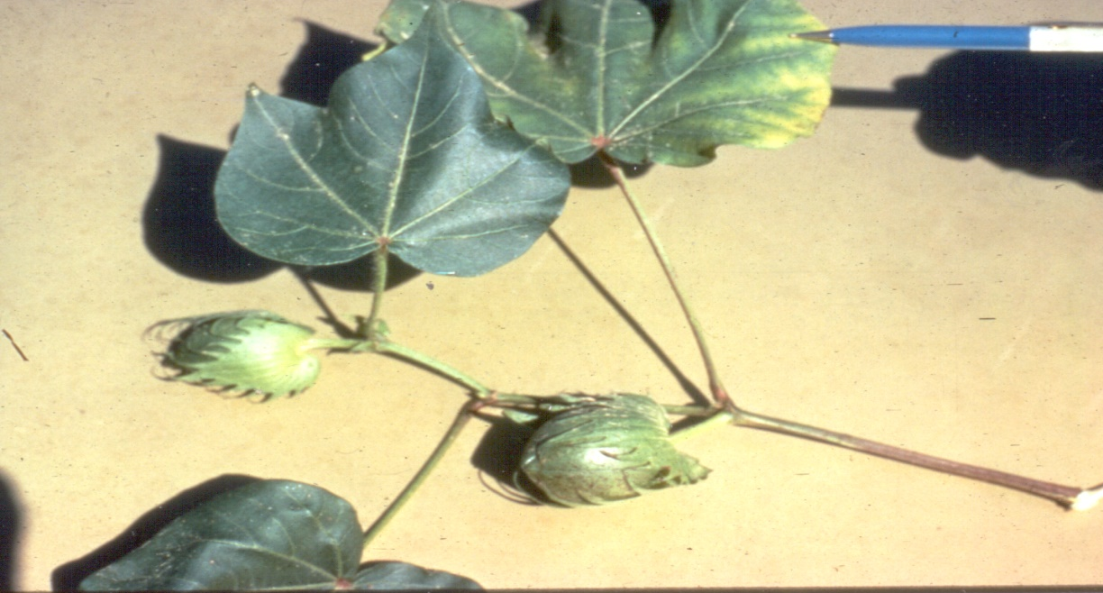
Cotton K Deficiency Symptom in the Upper Canopy
Rapid development of heavy boll load and boll maturation place big demand on plant K translocation
Mid- to late-season K Deficiency
Notes:
In much of the U.S. cotton belt, K deficiency occurs when bolls begin to develop and worsens with plant maturation, unless corrective measures are taken. Symptoms of marginal leaf chlorosis occur in the middle to upper canopy leaves. Bolls are tremendous sinks for K and translocation of K from leaves to subtending bolls accelerates development of deficiency symptoms.

Slide 33
Conclusions
Adequate K nutrition is critical in optimizing yield, quality, and profit in cotton production
Placement of K fertilizer is not as important as the appropriate rates of K
Soil application of K is the foundation of an effective program
Increased soil test K levels may be required for reduced or no-till systems or under compacted soil conditions
Soil test levels should be maintained in the medium to high range to assure consistent production, and that K does not limit cotton yield and quality

Slide 34
International Plant Nutrition Institute (IPNI) 655 Engineering Drive, Suite 110 Norcross, GA 30092-2604 Phone: 770-447-0335; Fax: 770-448-0439 Website: www.ipni.net
Reference 06128

Slide 35
