Slide 1

The value of
maintaining a good
soil test value
Robert Mullen
Director of Agronomy

Slide 2
Overview
A little on soil buffering capacity
  What it is, how it works
  Phosphorus
  Potassium

Slide 3
Soil Buffering Capacity
Buffering – ability of a system to resist change
As an example, adding 50 pounds of phosphorus fertilizer per acre will not result in a direct change in soil test equal to 50 pounds (some of the fertilizer P will go into insoluble precipitates and sorption sites on clay particles)
  Potassium does the same thing, but the potassium gets trapped between clay particles rather than forming precipitates
  Subsequent slides will provide the illustration

Slide 4
Buffering Capacity
Visual of what happens in soil
Solution P level
Total P in Soil
Notes:
Our goal with fertilization is to supply P or K to a level that results in increased availability of solution P or K. This slide is not too scale (it is not even close to reality). All that matters is this, if you want to see an increase in “solution P”, one has to add considerably more P to the “total P” side. This is a good visual of what buffering is. There are methods of determining different P fractions that relate to solution P (but we will not get into those).

Slide 5
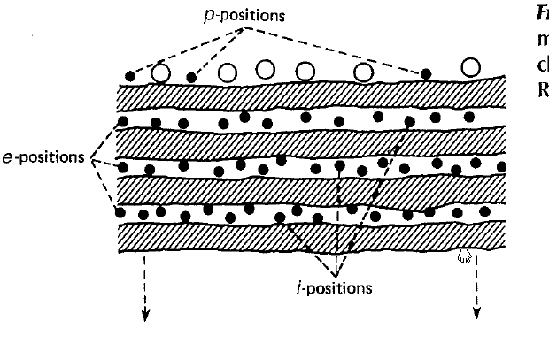
Potassium Buffering
Where Potassium is located relative to the clay is of utmost importance.
K trapped between clays (i-position) is slowly available to a plant
K in p and e positions is much more readily available
Notes:
Take home point – when we supply K via fertilization, some of what put into the soil system will get “trapped” – occluded between clays. This potassium is going to be very slowly plant available. Hence it is buffered.

Slide 6
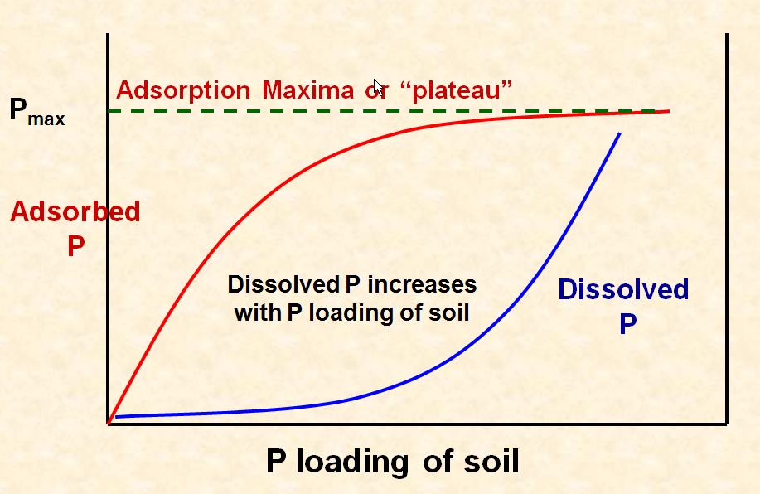
Phosphorus Buffering
Notes:
Our goal of fertilization is to increase dissolved P (because that is a form that a plant can actually lose). Notice that I have to add a lot of P (moving along the x-axis) to “satisfy” adsorption sites to cause an increase in dissolved P.

Slide 7
Why All This Matters?!?
If a farmer allows his soil test to decrease, the amount of fertilizer he/she has to supply to re-build soil test is higher than simply maintaining it.
  Let’s say as an example, at a decent soil test level for K my exchange rate is 3:1 (fertilizer applied to availability in soil). As my soil test levels decreases, now my exchange rate is 5:1.
  So rented ground that is being under-fertilized is exhausting historic supplies of P and K to the detriment of future profitability (assuming fertilizer prices do not fall below historic prices).
So money spent years and years ago to build up a soil test is being exhausted as they allow levels to decrease. And as you can imagine, soil nutrients were a lot less expensive in those days compared to today.

Slide 8


