Slide 1

Ohio Crop Production, Starters, and Foliar Fertilizers
Robert Mullen
Ph.D., CCA, CPAg.

Slide 2
Overview
Changing yield levels
  Does fertilization practices need to change?
  Impact on soil test levels
In-furrow fertilization
  Guidelines
Foliar fertilization
  Nutrient uptake/absorption

Slide 3
Changing Yield Levels

Slide 4
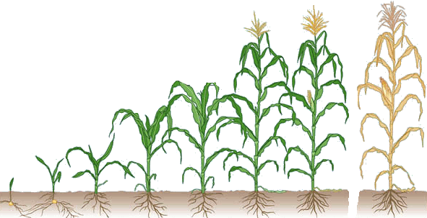

Yield, Nutrient Uptake, and Nutrient Removal
Corn
Yield – 200 bushels per acre
 | N | P2O5 | K2O
 | -----------pounds per acre----------
Uptake | 270 | 108 | 274
Removal | 151 | 83 | 60
Yield – 300 bushels per acre
 | N | P2O5 | K2O
 | -----------pounds per acre----------
Uptake | 406 | 162 | 412
Removal | 227 | 125 | 91
NH₄⁺
H₂PO₄⁻
K⁺
H₂PO₄⁻
K⁺
H₂PO₄⁻
K⁺
H₂PO₄⁻
H₂PO₄⁻
NO₃⁻
H₂PO₄⁻
K⁺
NO₃⁻
NO₃⁻
K⁺
NO₃⁻
NO₃⁻
NO₃⁻
Notes:
Notice how much crop removal increases as attainable yield increases. This new yield level absolutely requires a reevaluation of the fertilization strategy to keep up with higher removal rates.

Slide 5
Corn Nitrogen Uptake
Notes:
Approximately 75% of total N uptake is done by the time the corn crop turns reproductive (just before R1 – known as VT). Approximately 60% of the total N accumulated by the crop is removed in the harvested grain.

Slide 6
Corn Phosphorus Uptake
Removal
0.37 lbs/bu
Notes:
Approximately 50% of total P uptake is done by the time the corn crop turns reproductive (just before R1 – known as VT). Approximately 75-80% of the total P accumulated by the crop is removed in the harvested grain.

Slide 7
Corn Potassium Uptake
Removal
0.27 lbs/bu
Notes:
Approximately 90% of total K uptake is done by the time the corn crop turns reproductive (just before R1 – known as VT). Approximately 30% of the total K accumulated by the crop is removed in the harvested grain.

Slide 8
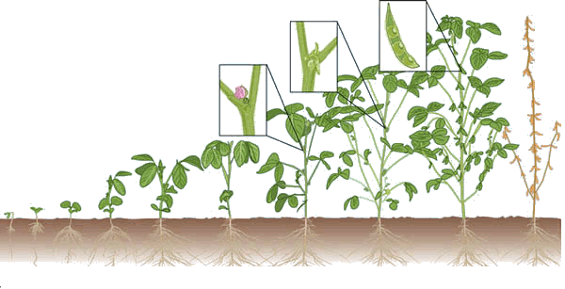
Yield, Nutrient Uptake, and Nutrient Removal
Soybean
Yield – 70 bushels per acre
 | N | P2O5 | K2O
 | -----------pounds per acre----------
Uptake | 343 | 76 | 161
Removal | 261 | 63 | 66
Yield – 100 bushels per acre
 | N | P2O5 | K2O
 | -----------pounds per acre----------
Uptake | 490 | 108 | 230
Removal | 372 | 90 | 94
K⁺
H₂PO₄⁻
K⁺
H₂PO₄⁻
H₂PO₄⁻
NH₄⁺
H₂PO₄⁻
K⁺
H₂PO₄⁻
K⁺
H₂PO₄⁻
K⁺
H₂PO₄⁻
K⁺
NO₃⁻
NO₃⁻
NO₃⁻
NO₃⁻
NO₃⁻
NO₃⁻
Notes:
Notice how much crop removal increases as attainable yield increases. This new yield level absolutely requires a reevaluation of the fertilization strategy to keep up with higher removal rates.

Slide 9
Soybean Nitrogen Uptake

Slide 10
Soybean Phosphorus Uptake
Removal
0.80 lbs/bu

Slide 11
Soybean Potassium Uptake
Removal
1.40 lbs/bu

Slide 12
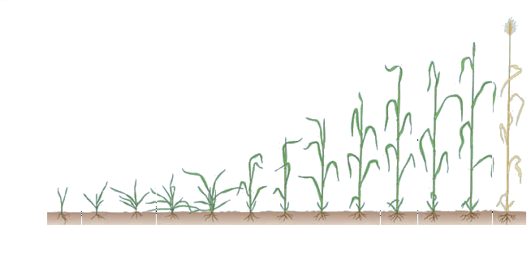
Yield, Nutrient Uptake, and Nutrient Removal
Wheat
Yield – 80 bushels per acre
 | N | P2O5 | K2O
 | -----------pounds per acre----------
Uptake | 176 | 61 | 123
Removal | 107 | 49 | 23
Yield – 120 bushels per acre
 | N | P2O5 | K2O
 | -----------pounds per acre----------
Uptake | 264 | 91 | 185
Removal | 162 | 73 | 35
NH₄⁺
H₂PO₄⁻
H₂PO₄⁻
K⁺
H₂PO₄⁻
K⁺
H₂PO₄⁻
K⁺
H₂PO₄⁻
H₂PO₄⁻
K⁺
K⁺
K⁺
K⁺
H₂PO₄⁻
H₂PO₄⁻
NO₃⁻
NO₃⁻
NO₃⁻
NO₃⁻
NO₃⁻
NO₃⁻
Notes:
Notice how much crop removal increases as attainable yield increases. This new yield level absolutely requires a reevaluation of the fertilization strategy to keep up with higher removal rates.

Slide 13
Wheat Nitrogen Uptake
Early leaf
Tillering
Stem elongation
Heading
Ripening

Slide 14
Wheat Phosphorus Uptake
Removal
0.63 lbs/bu
Early leaf
Tillering
Stem elongation
Heading
Ripening

Slide 15
Wheat Potassium Uptake
Removal
0.37 lbs/bu
Early leaf
Tillering
Stem elongation
Heading
Ripening

Slide 16
Corn Yields in Ohio
Increased by 72 bu/acre over the last 40 years

Slide 17
Soybean Yields in Ohio
Increased by 17 bu/acre over the last 40 years

Slide 18
Wheat Yields in Ohio
Increased by 31 bu/acre over the last 40 years

Slide 19
Phosphorus Removal in Ohio
Increased by 17 lb/acre over the last 40 years

Slide 20
Potassium Removal in Ohio
Increased by 21 lb/acre over the last 40 years

Slide 21
Phosphorus Fertilizer Sales in Ohio
Phosphorus fertilizer sales have decreased by 12%

Slide 22
Potassium Fertilizer Sales in Ohio
Potassium fertilizer sales have increased by 20%

Slide 23
Phosphorus from Manure in Ohio
Phosphorus generated from manure has decreased by 24%

Slide 24
Potassium from Manure in Ohio
Potassium generated from manure has decreased by 29%

Slide 25
Phosphorus Balance
Using a USDA-ERS adjusted model

Slide 26
Potassium Balance
Using a USDA-ERS adjusted model

Slide 27
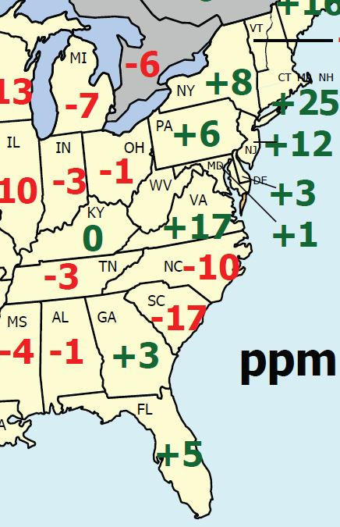
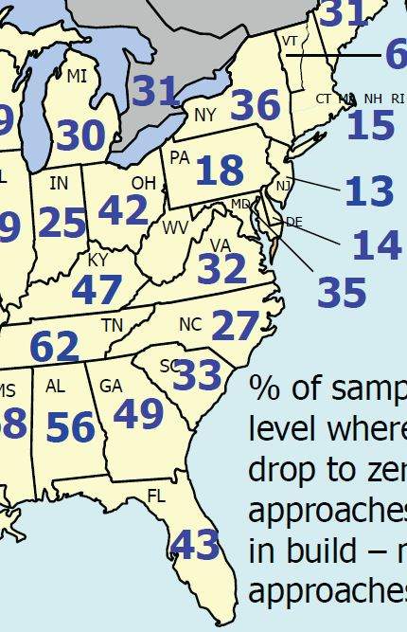
Soil Test P Levels
If balances are getting more negative, what are soil tests showing?
Change in STP from 2005 to 2010
Percent of samples testing below critical level

Slide 28
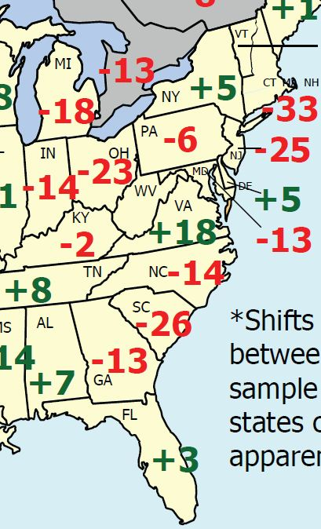
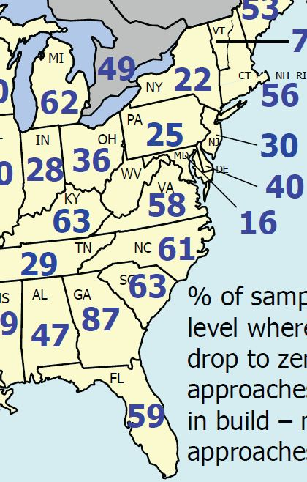
Soil Test K Levels
If balances are getting more negative, what are soil tests showing?
Change in STK from 2005 to 2010
Percent of samples testing below critical level

Slide 29
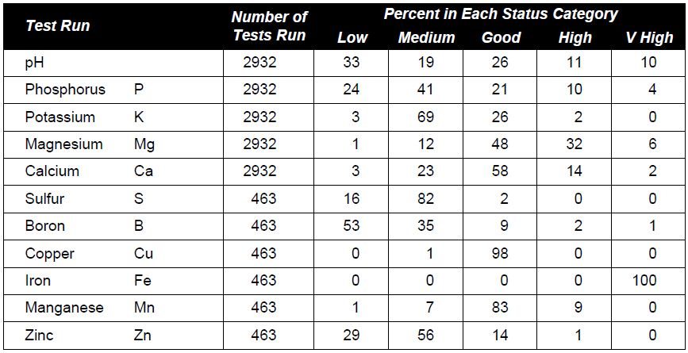
Your Own Soil Test Results

Slide 30
Starters

Slide 31
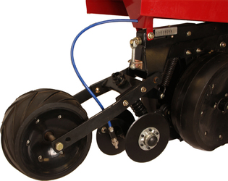
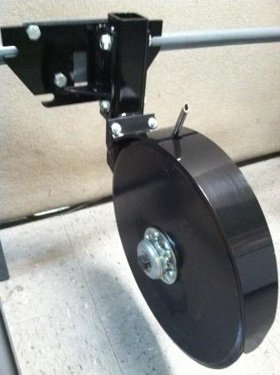
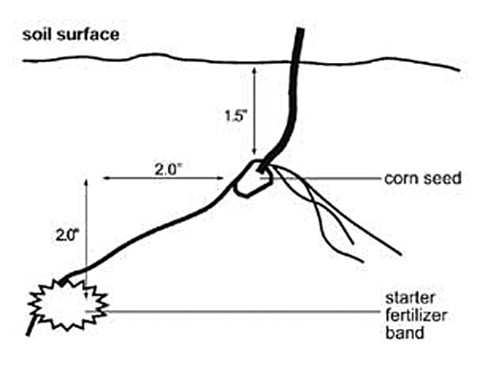
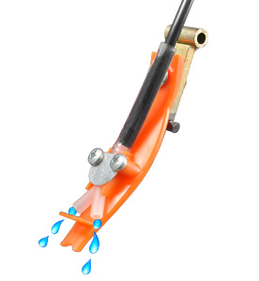
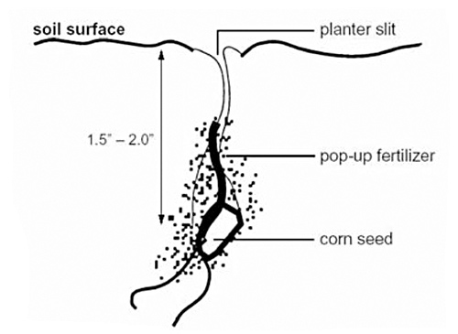
The Basics
Different types of application
  Row starter (2” x 2”)
  In-furrow

Slide 32
Row Starters
Positives:
  Higher application rates (seed safety always a concern with starters)
  App rates can be as high as 80 to 100 pounds of total salt (N + K₂O)
  Less concern with salt index of materials
Negatives:
  Requires additional application equipment and weight

Slide 33
In-Furrow Starters
Positives:
  Does not require much in the way of additional equipment
  Better proximal availability of less mobile nutrients (specifically micronutrients)
Negatives:
  Dramatically lower rates of application
  Total salt applications should not exceed 5 lbs/acre for coarse soils and 8-10 lb/acre for fine soils
  Greater concerns of salt index of materials

Slide 34
What Does Salt Index Mean?
Whenever you add a salt to a solution, some (or all) of it dissolves
When it dissolves it alters the osmotic potential of the solution
  Osmotic potential dictates where water will move (always moves down a concentration gradient)
  Water moves from an area with lower salt concentration to an area with higher salt concentration
  Osmotic potential is always negative, so an area with higher concentration of salts will have a more negative number

Slide 35
Osmotic Potential and Salt
A simple illustration
More salts, less water, more negative osmotic potential
Less salts, more water, less negative osmotic potential
Where will water move?

Slide 36
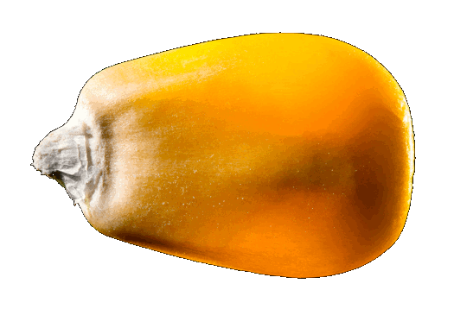
Think About a Germinating Seed
More salts, less water, more negative osmotic potential
Less salts, more water, less negative osmotic potential
Which will be easier for the seed to take water from?

Slide 37
Salt Index
Do all fertilizer materials have the same salt index?
Fertilizer material | Salt index per eq. wts. of materials | Salt index per unit of nutrients
Nitrogen/sulfur
Ammonia: 82% N | 47.1 | 0.572
Ammonium nitrate: 34% N | 104.0 | 3.059
Ammonium sulfate: 21% N, 24% S | 68.3 | 3.252
Ammonium thiosulfate: 12% N, 26% S | 90.4 | 7.533
Urea, 46% N | 74.4 | 1.618
UAN, 28%: 39% am. nit., 31% urea | 63.0 | 2.250
Phosphorus
APP: 10% N, 34% P2O5 | 20.0 | 0.455
DAP: 18% N, 46% P2O5 | 29.2 | 0.456
MAP: 11% N, 52% P2O5 | 26.7 | 0.405
Potassium
Monopotassium phosphate: 52% P2O5, 35% K2O | 8.4 | 0.097
Potassium chloride, 62% K2O | 120.1 | 1.936

Slide 38
Salt Index of Starter Formulations
Formulation | Salt index | Salt index per unit of plant nutrient
2-20-20ª | 7.2 | 0.17
3-18-18ª | 8.5 | 0.22
6-24-6ª | 11.5 | 0.32
6-30-10ª | 13.8 | 0.30
9-18-9ª | 16.7 | 0.48
10-34-0^{b} | 20.0 | 0.45
7-21-7^{c} | 27.8 | 0.79
4-10-10^{c} | 27.5 | 1.18
28-0-0^{c} | 63.0 | 2.25
a-formulated using potassium phosphate
b-use in row with caution; c-not recommended for in-row

Slide 39
Going Beyond Salt Index
There are other factors that determine the potential for salt injury
  Crop sensitivity
  Planter furrow width
  Row width
  Rainfall after planting

Slide 40
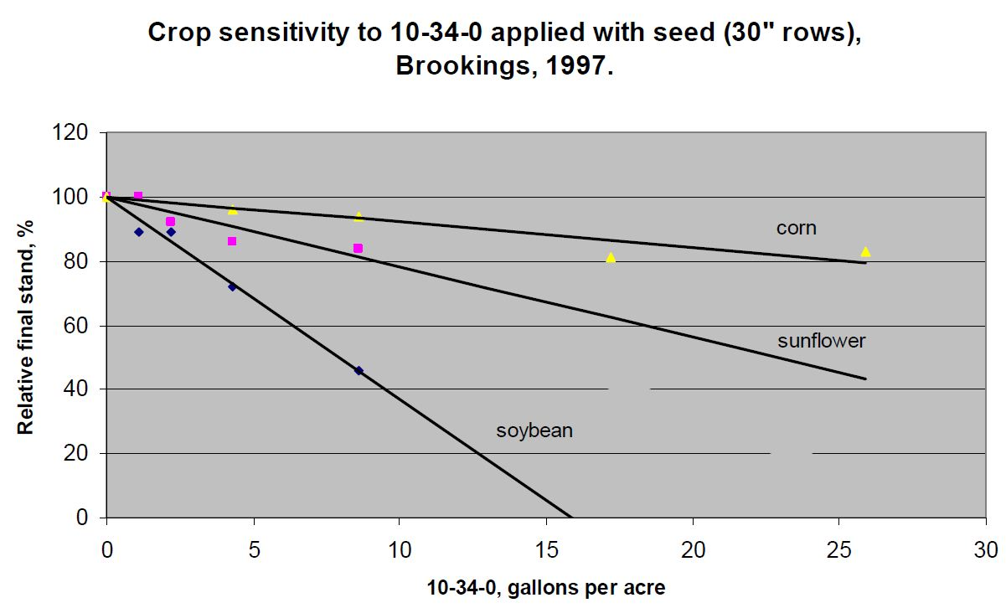
Crop Sensitivity
Crop | Relative sensitivity
Corn | 1.0
Barley | 1.7
Wheat | 2.2
Soybean | 5.1
Alfalfa | 7.3

Slide 41
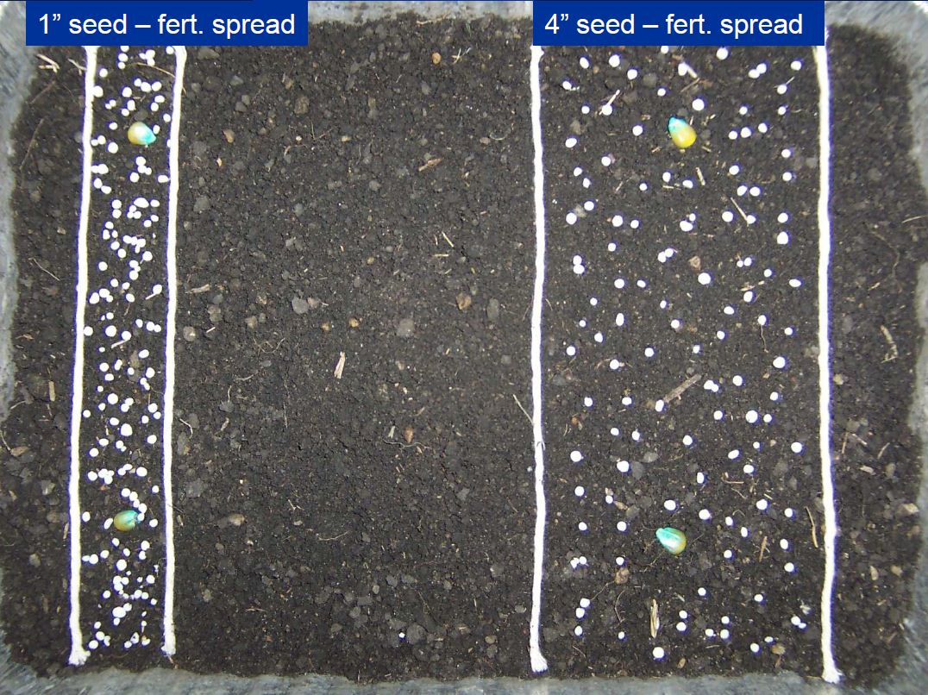
Planter Furrow Width

Slide 42
Agronomic Benefits
Without question, visual responses are very evident early during the growing season that starters are beneficial
  More vigorous growth, slightly advanced stage of growth
  Can have lower grain moisture level at harvest
Does not always translate into a yield benefit
  Dictated by
  Growing season (cooler temperatures – greater potential for yield benefit)
  Soil test levels (lower soil test levels – greater potential for yield benefit)
  Tillage (high residue systems – greater potential for yield benefit)

Slide 43
Foliar Fertilizers

Slide 44
Uptake Mechanism
Theorized uptake mechanisms:
  Movement through hydrophilic cuticular pores (nutrients in solution)
  Movement through the waxy cuticle (lipophilic materials only – non-polar)
  Uptake through stomata
Hydrophilic cuticular pores
Adaxial leaf surface (top)
Stomatal pore
Guard cells
Waxy cuticle
Epidermis
Palisade layer

Slide 45
Uptake Mechanism
Despite a good understanding of just how a nutrient moves into the leaf, we do know that they can and do get in
  Cotton research demonstrated that 30% of applied foliar N moved into the leaf within an hour, and it moved to the nearest boll within 6 to 48 hours
  Soybean research has demonstrated that foliar applied K can increase yield when the crop is K deficient
  Micronutrient research has demonstrated that foliar applications can increase nutrient concentration and yield when the nutrient is deficient

Slide 46
Does Adjuvant Matter?
It has been demonstrated that organosilicone surfactants can increase uptake of foliar nutrients
  But not always
No surfactant
Non-ionic surfactant
Organosilicone surfactant

Slide 47
Agronomic Benefits
What determines if there is a benefit?
From the plant demand side:
  Plant demand exceeds the soil’s ability to supply due to:
    Unfavorable pH, poor root growth, unfavorable environment
    Periods of peak demand
  Plant demand cannot be satisfied due to:
  Conditions that precluded application of materials to soil (wet, costly, etc.)

Slide 48
Agronomic Benefits
What determines if there is a benefit?
From the supply side (application of the foliar nutrient)
  Limit to how much can actually be applied
  Concerns with foliar burn, physiological limitation to uptake (nutrient size, charge, solution pH)
        Environmental conditions at the time of application
        Rain-free period, humidity, wind speed, etc.
        Use of adjuvants
        Improves leaf wetness by decreasing surface tension of solution

Slide 49
